Slide 1
Ross-on-Wye Town Centre User Survey - 2014 combined sources version
Collated: Friday, November 14, 2014

Slide 2
245
Total Responses, of which 33 Face-to-Face and 212 on Web
Date Created: Thursday, July 31, 2014
Complete Responses: 213

Slide 3
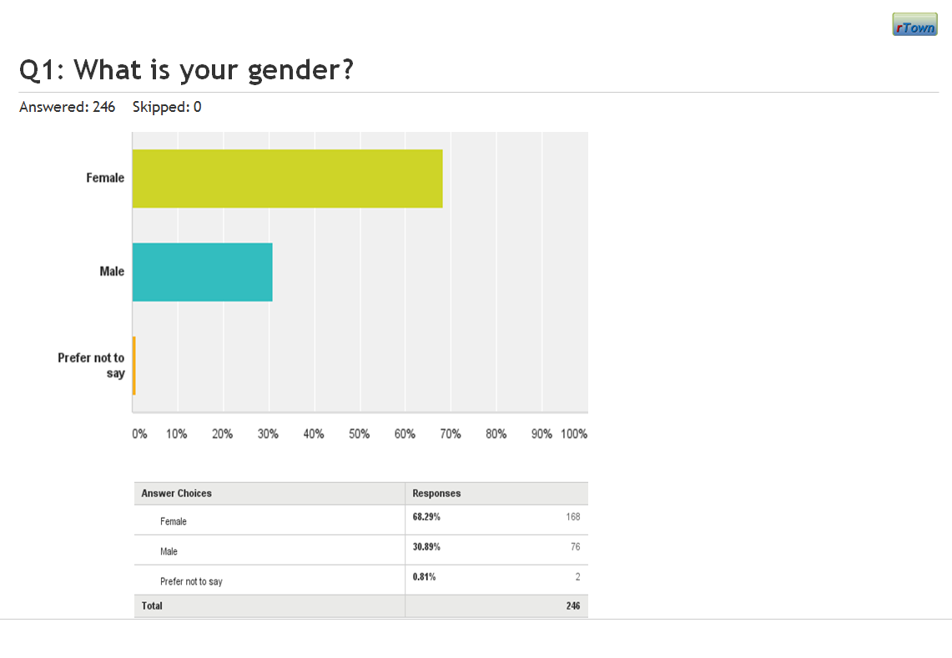
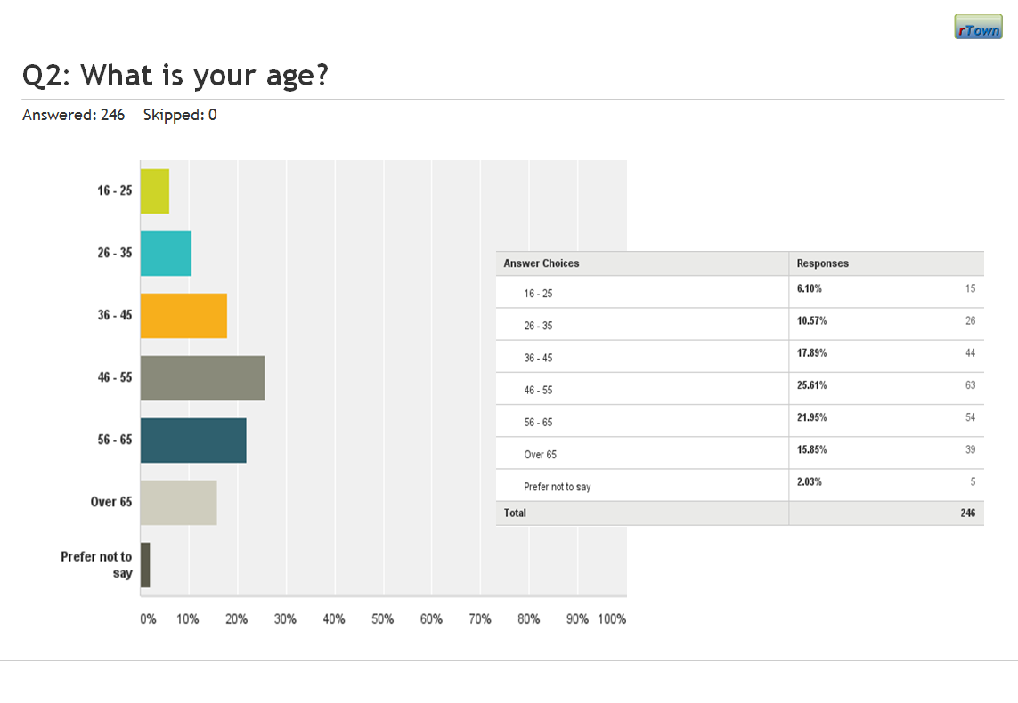
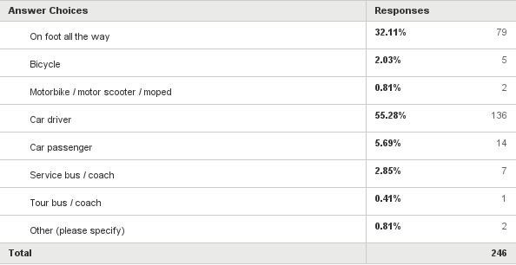
Notes
Numeric responses in SurveyMonkey are shown with raw data and graphics like this, or this:
Linked-to-next questions & comments in SurveyMonkey are shown like this:
Categorised free text responses exported from SurveyMonkey are, in this revised report, shown pie graphs derived, as corrected, from the exported Excel spreadsheet.

Slide 4
Notes on categorised free-text data
The two separate data collection methods resulted in 33 face-to-face interview (paper) responses and 212 web responses; a total of 245 responses.
The surveys were announced, made available online, and distributed on 5th August 2014 and were collected until 28th August 2014.
The graphical figures do not show the few responses not amenable to categorisation. In most cases the uncategorised responses are off topic, in some they have been merged to the structured responses, in a few cases they are notes related to manual input of data.
Important Note
In order to avoid misunderstanding of this data it is important to read it alongside the response subset recorded in the survey tool (shown under the banner for each slide). Respect for these numeric details can, alone, put the analyses of the free text comments into context. For example, where there seems to be a preponderance of negative responses it could be that those are associated with a minority of negative responses amongst an overwhelmingly positive (but uncommented) response to the structured question to which the comments relate.
The slightly revised spreadsheets (incorporating corrections to mis-entries) which permit these connections to be made safely will be posted to the Project working documents area of the website.

Slide 5
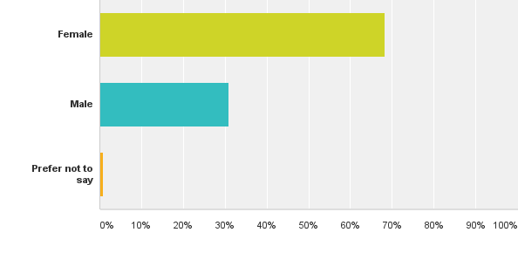
Q1: What is your gender?
Answered: 245 Skipped: 0

Slide 6
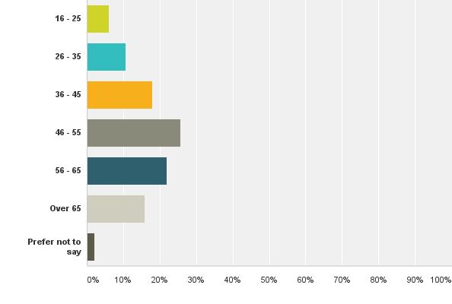
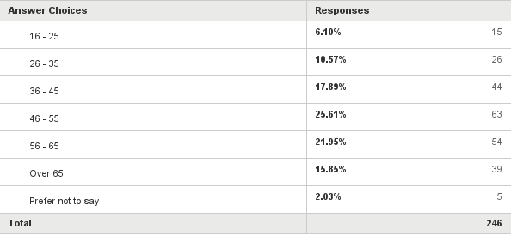
Q2: What is your age?
Answered: 245 Skipped: 0

Slide 7
Q3: Town centre user origin from Post Code
Answered: 245 Skipped: 0

Slide 8
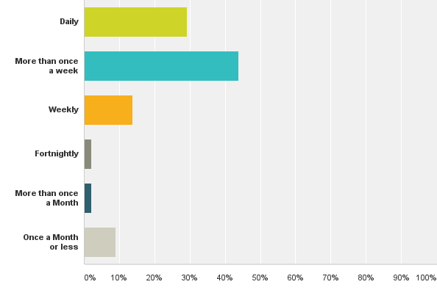
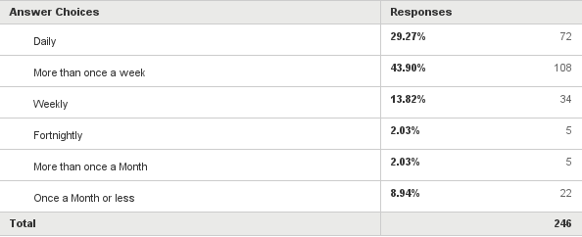
Q4: How often do you visit Ross-on-Wye town centre?
Answered: 245 Skipped: 0

Slide 9
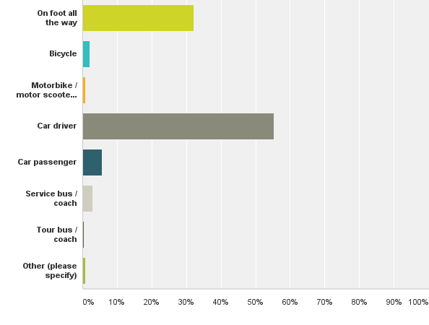
Q5: How did you travel into Ross-on-Wye town centre on your most recent visit?
Answered: 245 Skipped: 0

Slide 10
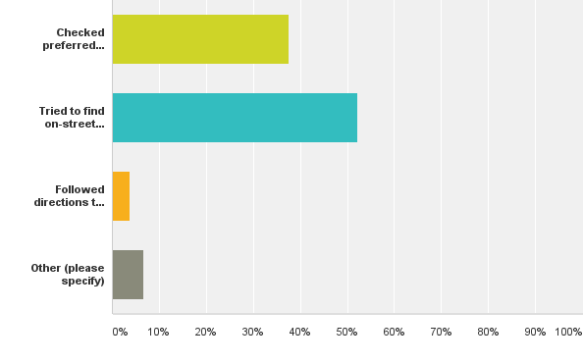
Q6: As the car driver, how did you select your parking place on your most recent visit?
Answered: 136 Skipped: 110

Slide 11
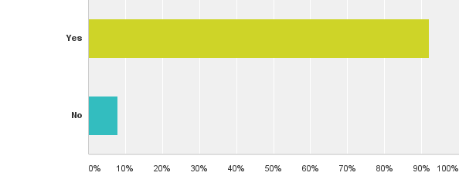
Q7: Was your preferred parking place available?
Answered: 51 Skipped: 195

Slide 12
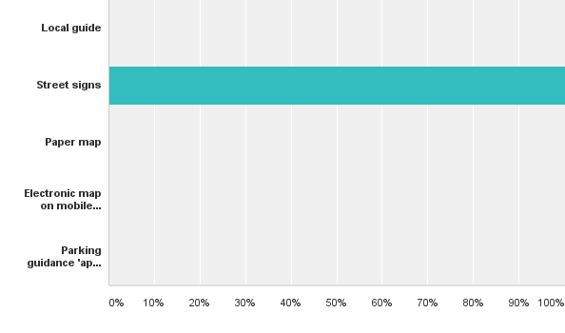
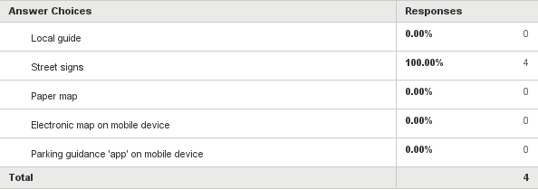
Q8: Which of the following direction aids to an off-street car park did you use?
Answered: 4 Skipped: 242

Slide 13
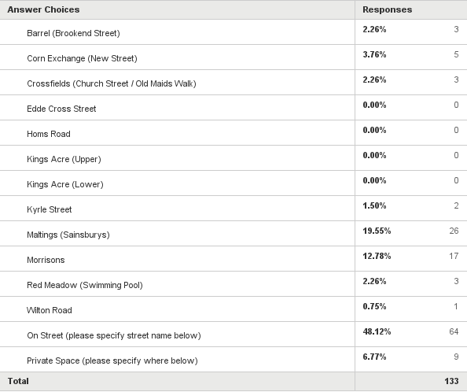
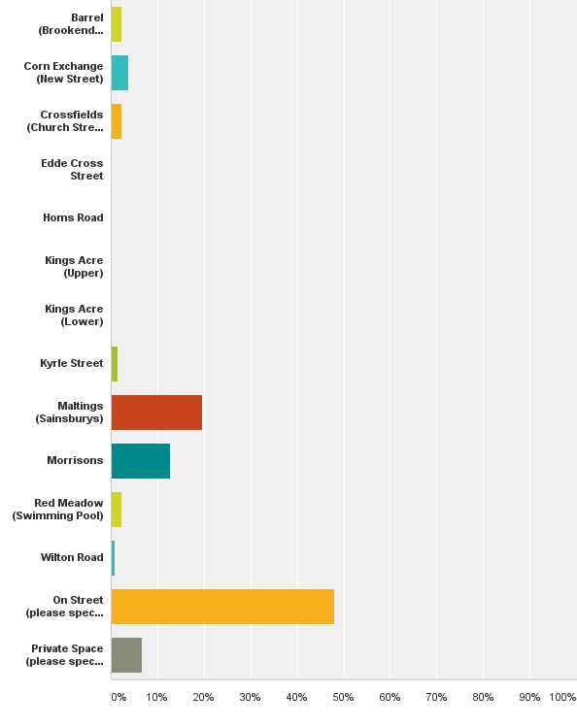
Q9: Where did you actually park?
Answered: 133 Skipped: 113

Slide 14
Q9: Categorised comments related to “Where did you actually park” – On street and Private options
Comments: as 68 categorised comments

Slide 15
Q10: Categorised comments related to "What was the main purpose of your most recent visit to Ross-on-Wye town centre?"
Answered: 234 Skipped: 12

Slide 16
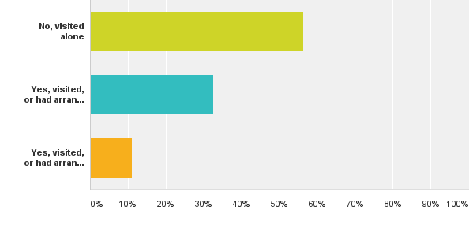
Q11: Did anyone visit Ross-on-Wye town centre with you on your most recent visit?
Answered: 234 Skipped: 12

Slide 17
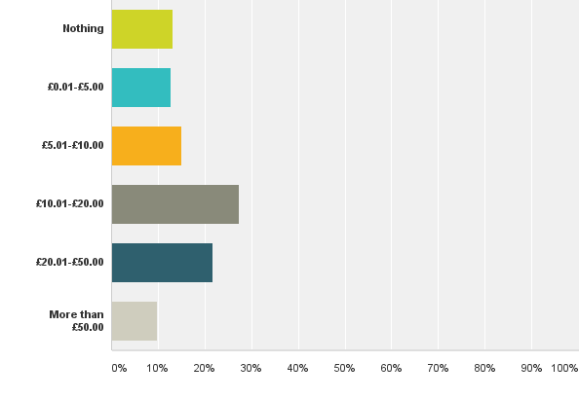
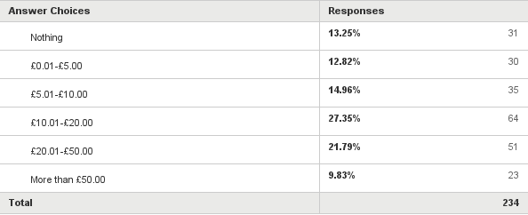
Q12: Roughly how much money did you spend in Ross-on-Wye town centre on your most recent visit?
Answered: 234 Skipped: 12

Slide 18
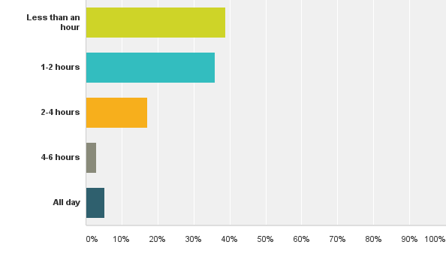
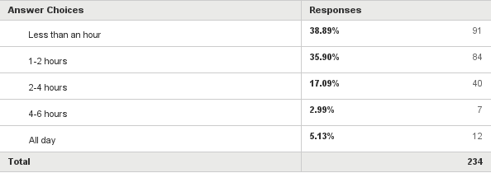
Q13: How long did you stay in Ross-on-Wye town centre on your most recent visit?
Answered: 234 Skipped: 12

Slide 19
Q14: Categorised comments related to “Was the time you spent in Ross-on-Wye town centre on your most recent visit limited?"
Answered: 234 Skipped: 12

Slide 20
Q14: Categorised comments related to “Was the time you spent … limited?" – Other option
Comments: 32 as 62 categorised comments

Slide 21
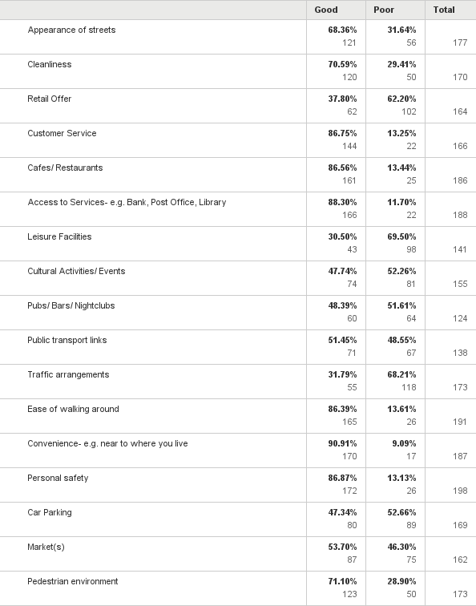
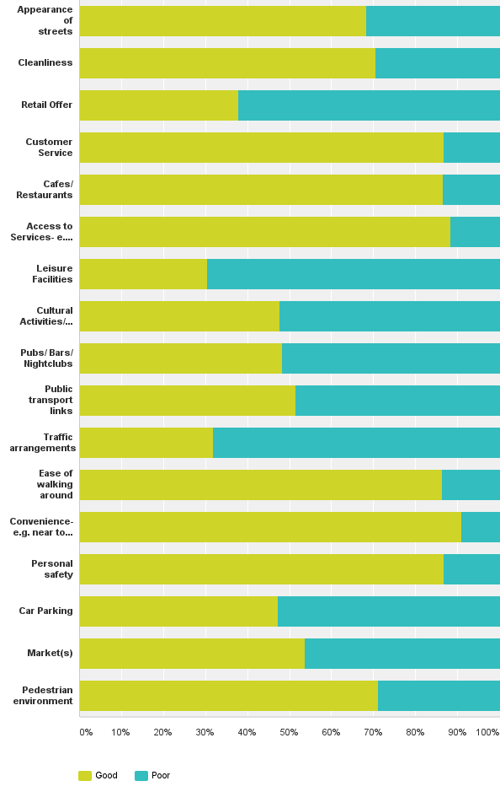
Q15: How do you rate the following aspects of Ross-on-Wye town centre? Leave lines blank if you have no opinion - or the rating is 'fair'.
Answered: 225 Skipped: 21

Slide 22
Q15: Categorised comments related to “How do you rate the following aspects …” – Comment option
Comments: 50 as 80 categorised comments

Slide 23
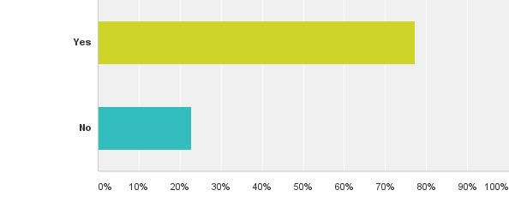
Q16: Would you recommend a visit to Ross-on-Wye town centre?
Answered: 224 Skipped: 22

Slide 24
Q16: Categorised comments related to "Would you recommend a visit … ?" – Comment option
Comments: 122 as 171 categorised comments

Slide 25
Q17: Categorised responses to “What one improvement would persuade you to visit … more often, or stay longer?”
Answered: 185 as 206 categorised comments

Slide 26
Q17: Analysis of Categorised responses indicating a wish for a better consumer offer
Comments: 91 responses as 93 categorised comments

Slide 27
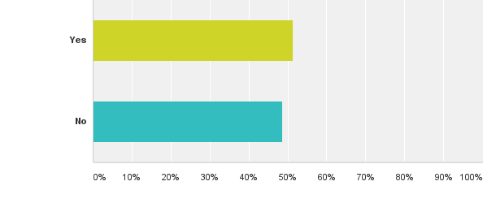
Q18: Do you think financial or other incentives would persuade you to make more use of Ross-on-Wye town centre shops and facilities?
Answered: 224 Skipped: 22

Slide 28
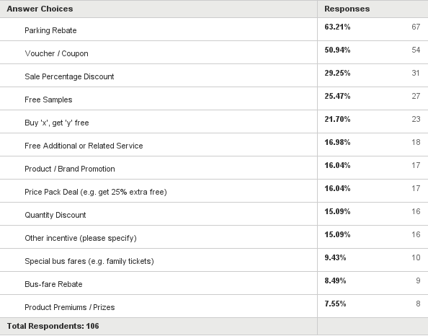
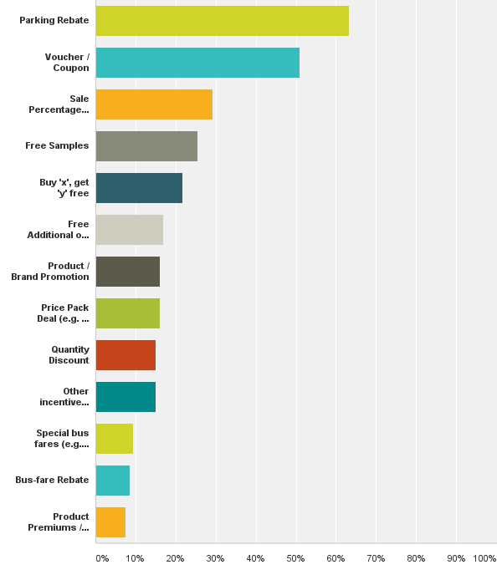
Q19: Please chose no more than the four (4) most attractive of these incentives:
Answered: 106 Skipped: 140

Slide 29
Q19: Categorised responses to “Please chose no more than the four (4) most attractive of these incentives” – Other option
Comments: 16 as 17 categorised comments

Slide 30
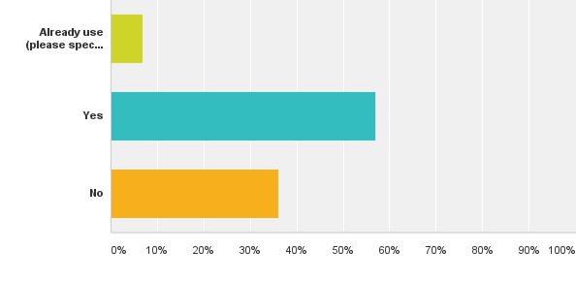
Q20: Would you use internet shopping to ‘click & collect’ if town traders were to offer it?
Answered: 219 Skipped: 27

Slide 31
Q20: Categorised comments to “Would you use internet shopping to ‘click & collect’ if town traders were to offer it?”
Comments: 38 as 40 categorised comments

Slide 32
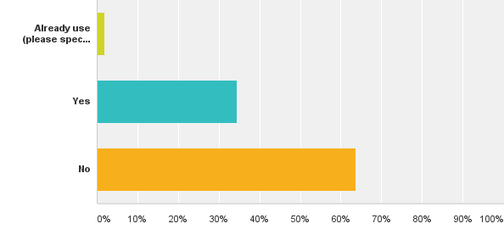
Q21: Would you use phone shopping to ‘shop & collect’ if town traders were to offer it?
Answered: 218 Skipped: 28

Slide 33
Q21: Categorised comments to “Would you use phone shopping to ‘shop & collect’ if town traders were to offer it?”
Comments: 21 as 21 categorised comments

Slide 34
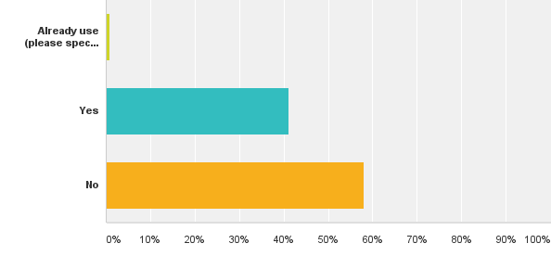
Q22: Would you use a ‘buy now, collect from elsewhere in Ross-on-Wye later’ service if town traders were to offer it?
Answered: 219 Skipped: 27

Slide 35
Q22: Categorised comments to “Would you use a ‘buy now, collect from elsewhere in Ross-on-Wye later’ service if town traders were to offer it?”
Comments: 16 as 19 categorised comments

Slide 36
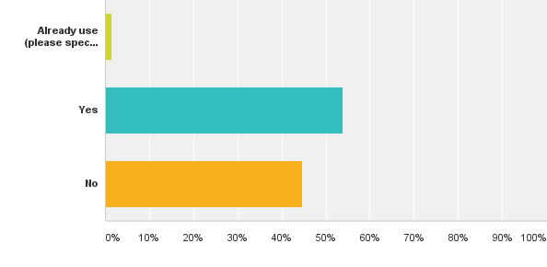
Q23: Would you use timed local delivery if town traders were to offer it?
Answered: 219 Skipped: 27

Slide 37
Q23: Categorised comments to “Would you use timed local delivery if town traders were to offer it?”
Comments: 19 as 27 categorised comments

Slide 38
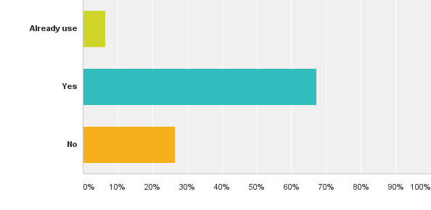
Q24: Would you use a unified town information service to find out about accommodation, outlets, services and promotions?
Answered: 219 Skipped: 27

Slide 39
Q24: Categorised comments to “Would you use a unified town information service to find out about accommodation, outlets, services and promotions?”
Comments: 12 as 17 categorised comments

Slide 40
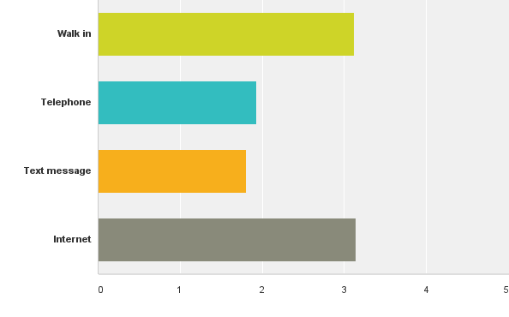
Q26: Please rank the sort of information source about accommodation, outlets, services and promotions you prefer to use.
Answered: 156 Skipped: 90

Slide 41
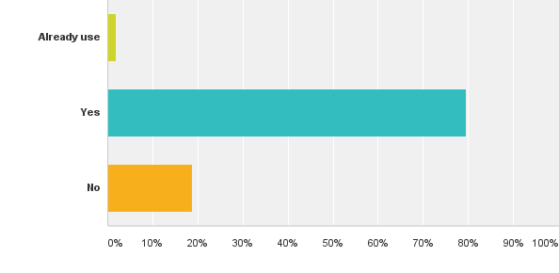
Q27: Would you use a unified town service to report problems with aspects of the town?
Answered: 214 Skipped: 32

Slide 42
Q29: Categorised comments to “Would you use a unified town service to report problems with aspects of the town?”
Comments: 4 as 4 categorised comments

Slide 43
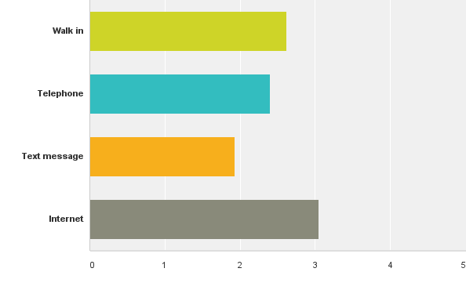
Q29: Please rank the sort of service you prefer to use to report problems with aspects of the town.
Answered: 171 Skipped: 75

