Slide 1
Ross-on-Wye Town Centre Business Survey - 2014 combined sources version
Collated: Friday, November 14, 2014

Slide 2
61
Total Responses, of which 43 on Paper and 18 on Web
Date Created: Thursday, July 31, 2014
Complete Responses: 54

Slide 3
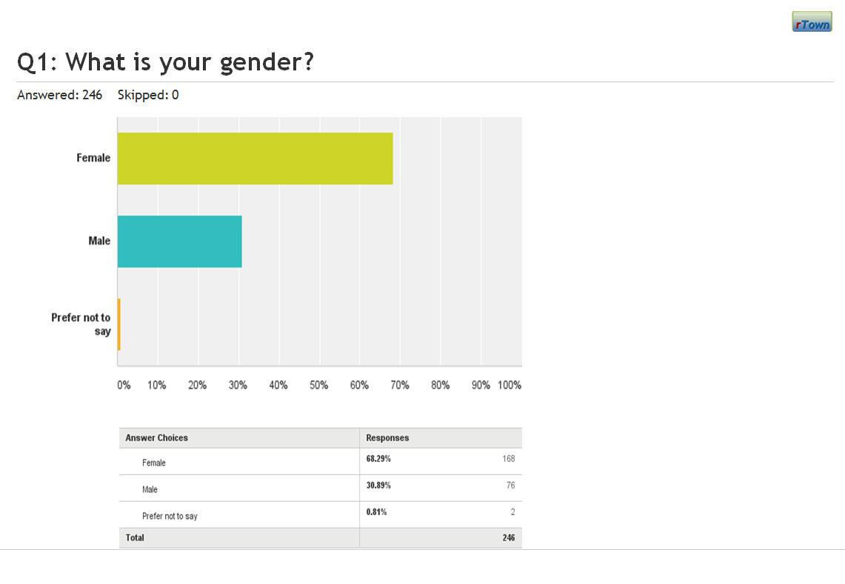
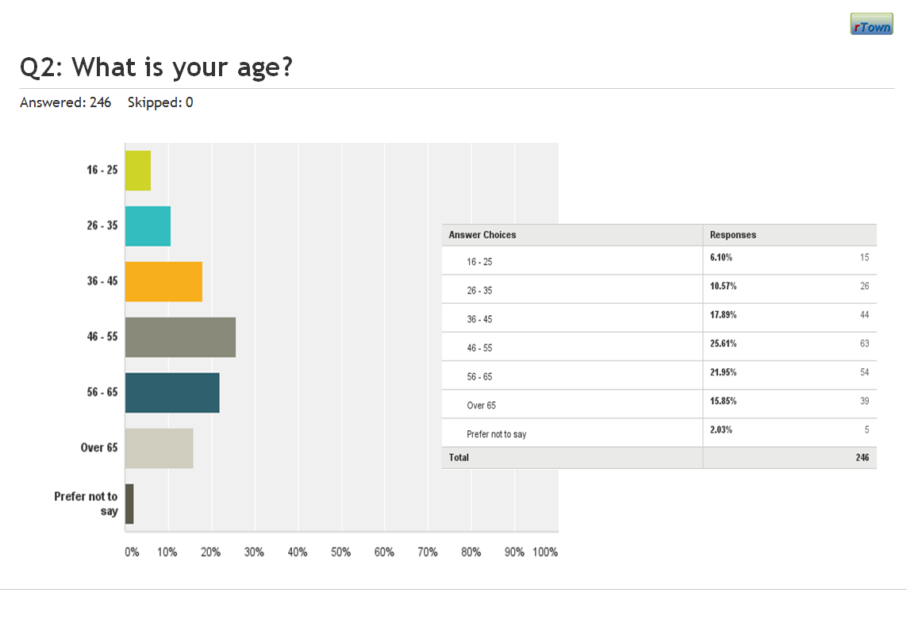
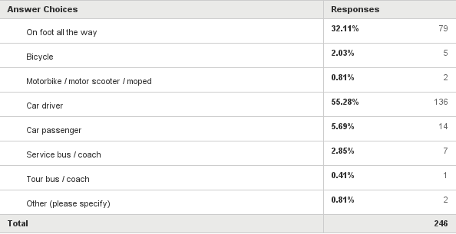
Notes
Numeric responses in SurveyMonkey are shown with raw data and graphics like this, or this:
Linked-to-next questions & comments in SurveyMonkey are shown like this:
Categorised free text responses in SurveyMonkey are shown like this:

Slide 4
Notes on categorised free-text data
The two separate data collection methods resulted in 43 paper responses and 18 web responses; a total of 61 responses.
The surveys were announced, made available online, and distributed on 5th August 2014 and were collected, mailed and submitted between 8th August and 22nd September 2014.
The graphical figures do not show the few responses not amenable to categorisation. In most cases the uncategorised responses are off topic, in a few cases they are notes related to manual input of data.
Important Note
In order to avoid misunderstanding of this data it is important to read it alongside the response subset recorded in the survey tool (shown under the banner for each slide). Respect for these numeric details can, alone, put the analyses of the free text comments into context. For example, where there seems to be a preponderance of negative responses it could be that those are associated with a minority of negative responses amongst an overwhelmingly positive (but uncommented) response to the structured question to which the comments relate. The spreadsheets which will permit these connection to be made safely will be posted to the Project working documents area of the website, but are still being collated as these reports are made available.

Slide 5
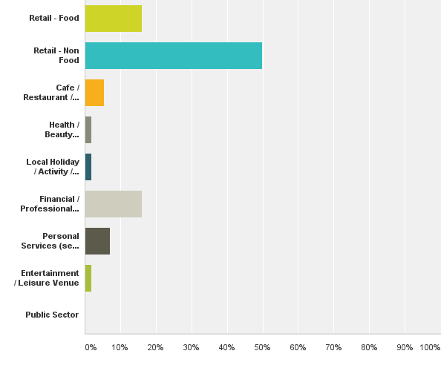
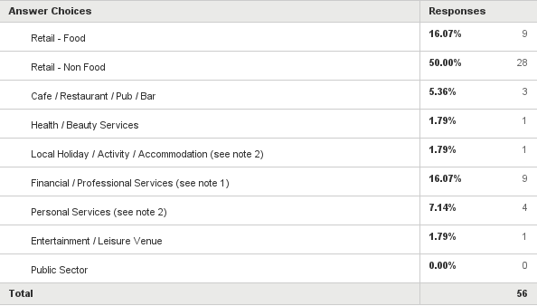
Q1: What is the nature of your business?
Answered: 56 Skipped: 5

Slide 6
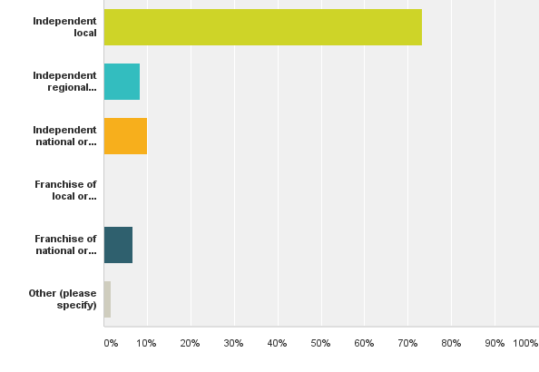
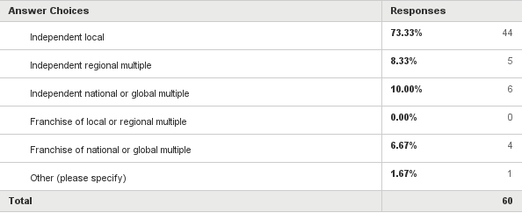
Q2: What type of business are you?
Answered: 60 Skipped: 1

Slide 7
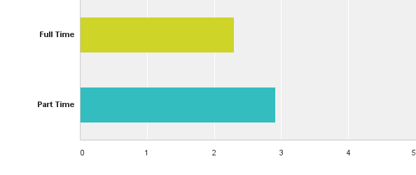
Q3: How many people work at the premises where the invitation to complete this questionnaire was delivered?
Answered: 61 Skipped: 0

Slide 8
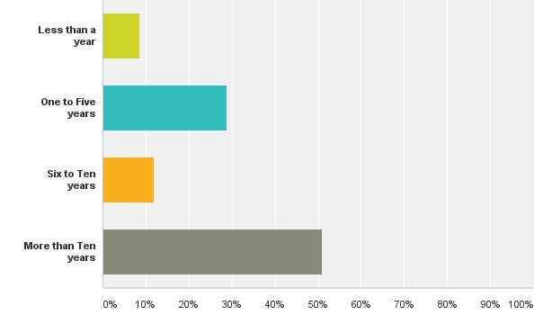
Q4: How long has this business been in Ross-on-Wye?
Answered: 59 Skipped: 2

Slide 9
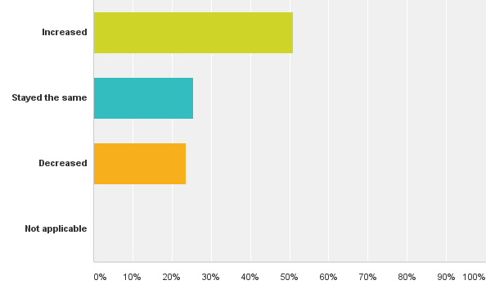
Q5: Compared to a year ago has your turnover in Ross-on-Wye?
Answered: 55 Skipped: 6

Slide 10
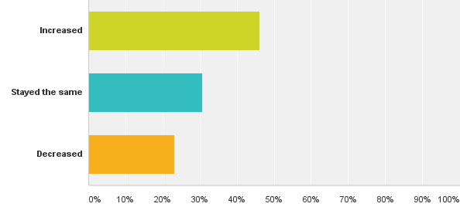
Q6: Compared to a year ago has your profitability in Ross-on-Wye?
Answered: 52 Skipped: 9

Slide 11
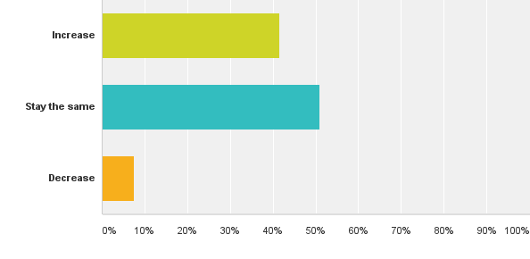
Q7: Over the next 12 months do you think your turnover in Ross-on-Wye will?
Answered: 53 Skipped: 8

Slide 12
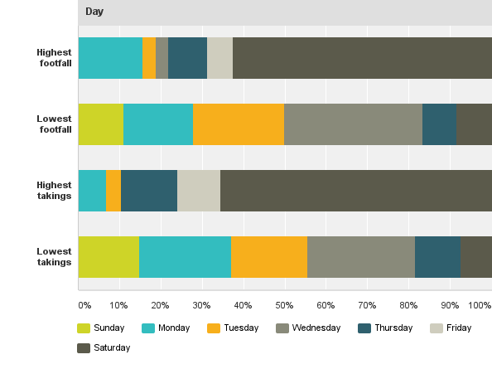
Q8: What is the typical pattern of your estimated footfall, and takings, by day?
Answered: 41 Skipped: 20

Slide 13
Q8: What is the typical pattern of your estimated footfall, and takings, by day?
Answered: 41 Skipped: 20

Slide 14
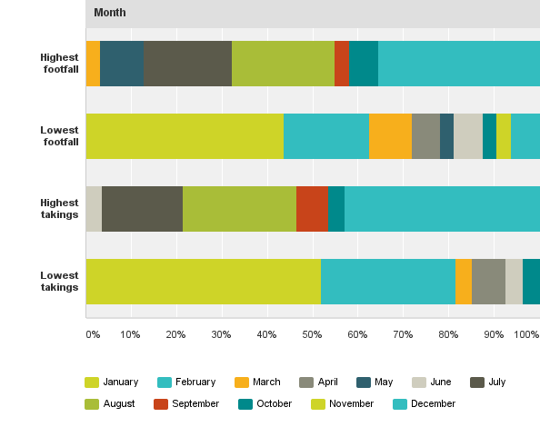
Q8: What is the typical pattern of your estimated footfall, and takings, by month?
Answered: 41 Skipped: 20

Slide 15
Q8: What is the typical pattern of your estimated footfall, and takings, by month?
Answered: 41 Skipped: 20

Slide 16
Q9.1: What are the positive and negative aspects of having a business located in Ross-on-Wye?
Answered: 56 Skipped: 5

Slide 17
Q9.2: What are the positive and negative aspects of having a business located in Ross-on-Wye?
Answered: 56 Skipped: 5

Slide 18
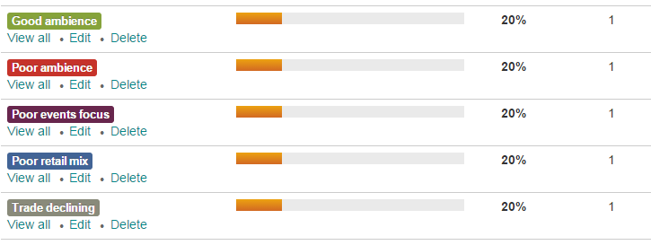
Q9: Categorised comments related to “What are the positive and negative aspects …” – Comment option
Comments: 5

Slide 19
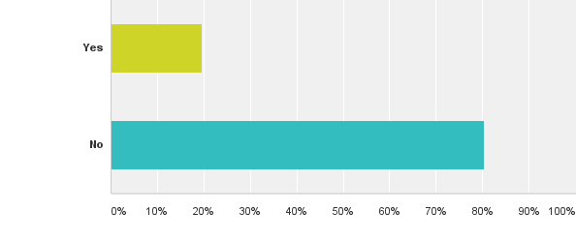
Q10: Has your business in Ross-on-Wye suffered from any crime over the last 12 months?
Answered: 56 Skipped: 5

Slide 20
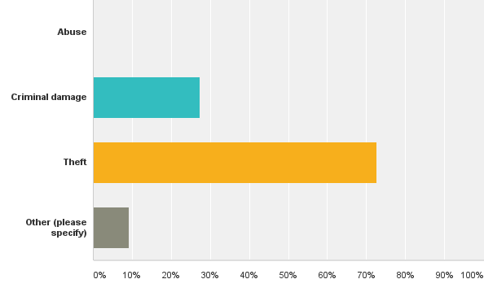
Q11: What type of crime has your business in Ross-on-Wye suffered over the last 12 months?(Please tick all that apply)
Answered: 11 Skipped: 50

Slide 21
Q12: Categorised comments related to “What one action would in your opinion generally increase regular trade in Ross-on-Wye town centre?” – Comment option
Answered: 49 Skipped: 12

Slide 22
Q13: Categorised comments related to “What one action would in your opinion generally increase tourist trade in Ross-on-Wye town centre?” – Comment option
Answered: 48 Skipped: 14

Slide 23
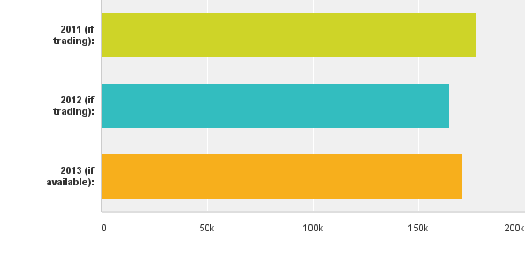
Q14: What was your gross, Ross-on-Wye, turnover in these trading years?
Answered: 9 Skipped: 52

Slide 24
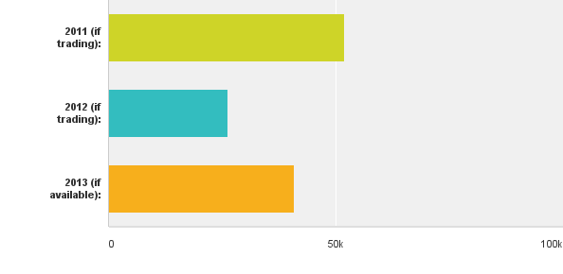
Q15: What was your gross, Ross-on-Wye, margin in these trading years?
Answered: 8 Skipped: 53

Slide 25
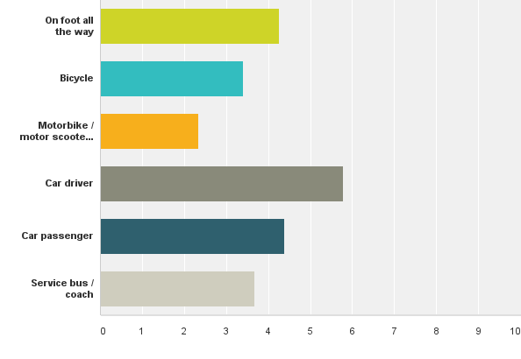
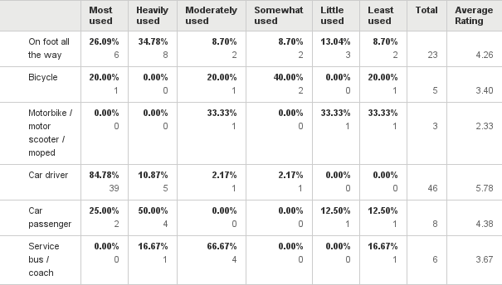
Q16: Please rank how you and any staff normally travel to your business.
Answered: 51 Skipped: 10

Slide 26
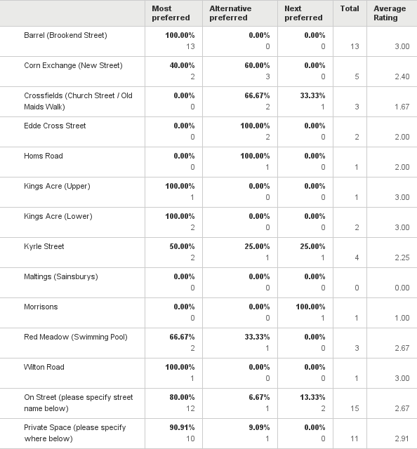
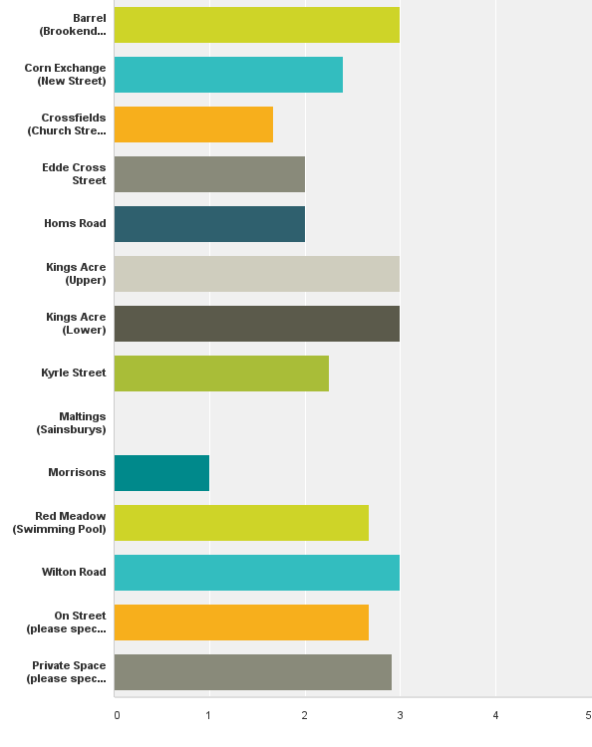
Q17: Which three motorcycle / car parking places do you and any staff normally try to use?
Answered: 45 Skipped: 16

Slide 27
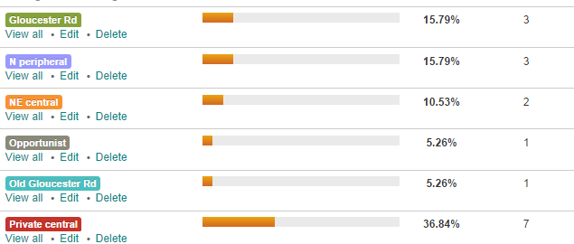
Q17: Categorised comments related to “Which three motorcycle / car parking places do you and any staff normally try to use?” – On street and Private options
Responses: 19

Slide 28
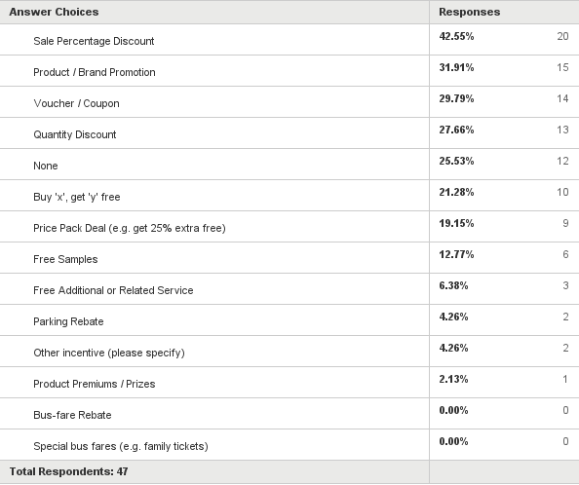
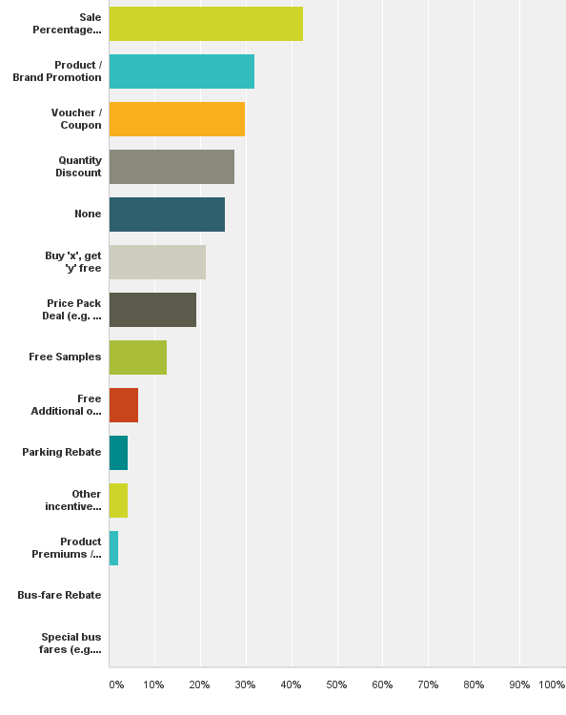
Q18: What, if any, type of financial or other incentives have you (not product manufacturer / distributor) used previously?
Answered: 47 Skipped: 14

Slide 29
Q18: Categorised comments related to “What, if any, type of financial or other incentives have you (not product manufacturer / distributor) used previously?” – Other comments
Comments: 2

Slide 30
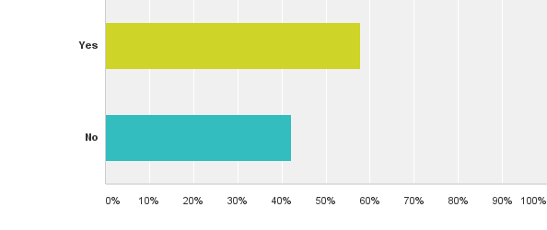
Q19: Would you consider providing financial or other incentives for customers, together with other traders, that are designed to boost trade
Answered: 45 Skipped: 16

Slide 31
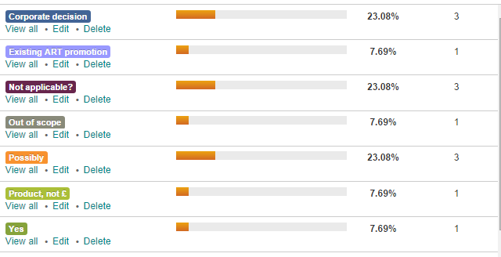
Q19: Categorised comments related to “Would you consider providing financial or other incentives …, together with other traders, that are designed to boost trade?” – Other comments
Responses: 13

Slide 32
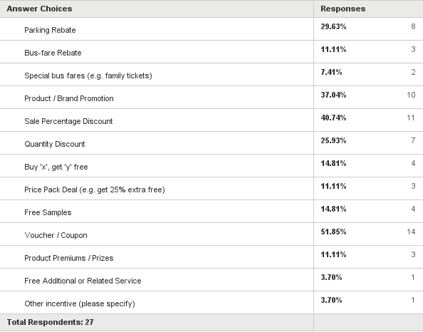
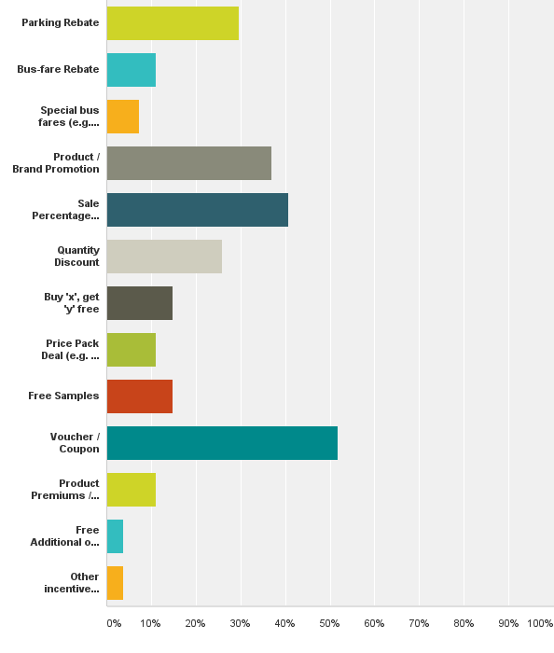
Q20: What type of financial or other incentives would you consider? Please tick all that apply.
Answered: 27 Skipped: 34
re: Parking Rebate - “make people feel good to shop local”

Slide 33
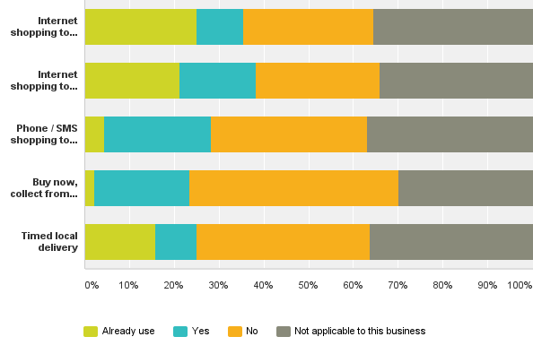
Q21: Do you, or would you if available on a trial basis, offer?
Answered: 52 Skipped: 9
Internet shopping to ‘click & despatch’
Internet shopping to ‘click & collect’
Phone / SMS shopping to ‘shop & collect’
Buy now, collect later from somewhere else in Ross Timed local delivery

Slide 34
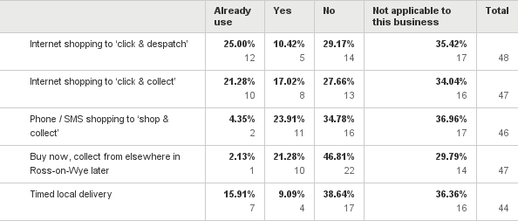
Q21: Do you, or would you if available on a trial basis, offer?
Answered: 52 Skipped: 9

Slide 35
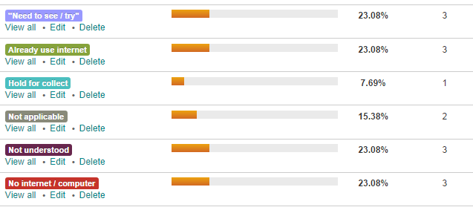
Q21: Categorised comments related to “Do you, or would you if available on a trial basis, offer?” – Other comments
Responses: 13
Internet shopping to ‘click & despatch’ Internet shopping to ‘click & collect’
Phone / SMS shopping to ‘shop & collect’ Buy now, collect from somewhere else in Ross later Timed local delivery

Slide 36
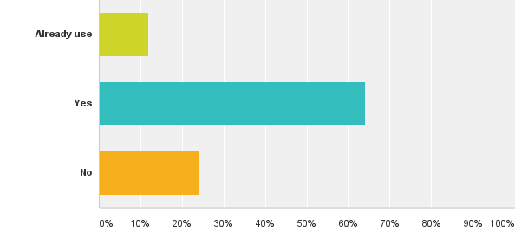
Q22: Do you, or would you, use a unified town information service to publicise your business, products, services and promotions?
Answered: 50 Skipped: 11

Slide 37
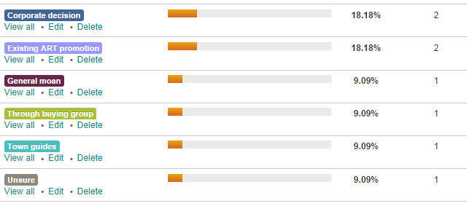
Q22: Categorised comments related to “Do you, or would you, use a unified town information service to publicise your business, products, services and promotions?” - Comments
Comments: 11

Slide 38
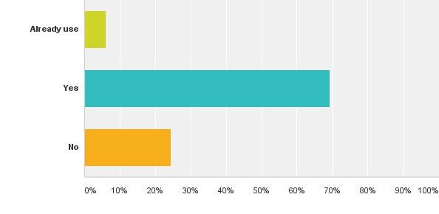
Q23: Do you, or would you, use a unified town service to report problems with aspects of the town?
Answered: 49 Skipped: 12

Slide 39
Q24: Categorised responses related to “What service do you already use to report problems with aspects of the town?”
Responses: 4

Slide 40
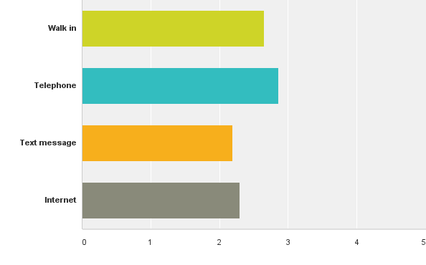
Q25: Please rank the sort of service you prefer to use to report problems with aspects of the town.
Answered: 37 Skipped: 24

